Slide 1
Managing a “Data Spill”
Florida Industrial Security Working Group (FISWG)
2015 Fall Training Session
Orlando, Florida
September 24, 2015
Presented by: Randy Riley
Lockheed Martin Missiles and Fire Control

Slide 2
Objectives
We will Review and Discuss
A description or definition of a classified data spill
Some common causes of data spills
Personnel responsibilities
Facility reporting requirements
Incident response plans
Additional spill cleanup considerations
The “Final Report,” or administrative inquiry
2

Slide 3
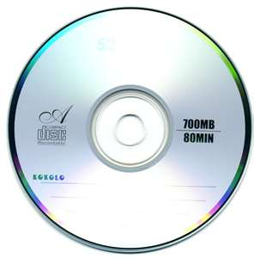
What is a Classified Data Spill?
A “spill” is classified data introduced onto a system operating at a lower classification level.
The most common spill scenario is classified data introduced onto an unclassified system.
A spill is also referred to as a contamination or classified message incident.
SECRET
Unclassified
3
Ref: DSS ISFO Process Man Rev 3.2 4.5.1 (p. 43)

Slide 4
Some Common Causes of Spills
Not following procedures
Didn’t understand requirements
Inadequate SME data review
Data received from outside source (i.e. email, CD/DVD)
Compilation of data
Other examples?
4

Slide 5
When a Spill Occurs
All personnel involved should
Immediately open lines of communication
Participate in, and support, response efforts
Not delete data until instructed to do so
Assess risk and follow data owner (customer) guidelines and/or approved procedures
Assign cleared people to assist with cleanup
5
Ref: DSS ISFO Process Man Rev 3.2 4.5.5 (p. 47)

Slide 6
ISSM/ISSO Responsibilities
Assess extent of spill and plan cleanup actions
Isolate the spill to prevent contamination spread
Confiscate and protect affected PEDs
Ensure personnel with appropriate clearance conduct spill cleanup
Contact GCA for spill clean up guidance and/or to obtain concurrence with contractors’ existing procedures
Report findings and description of cleanup actions through the FSO
6
Ref: DSS ISFO Process Man Rev 3.2 4.5.5 (p. 47)

Slide 7
FSO Responsibilities
Notify government agencies as required
Determine the classification level of data
Identify individuals and communication channels involved in the spill
Act as incident lead for multi-site spills originating from local facility
Other actions depending upon situation and guidance received
7
Ref: DSS ISFO Process Man Rev 3.2 4.5.5 (p. 47)

Slide 8
Where to begin?
Determine scope of spill, classification level, and enough detail to make an initial report
Assemble the (cleared) response team
Protect all contaminated equipment
Prevent access by unauthorized personnel

Slide 9
Loss, Compromise, or Suspected Compromise
Loss: material can’t be located within a reasonable period of time
Compromise: disclosure to unauthorized person(s)
Suspected compromise: disclosure can’t reasonably be precluded or ruled out
9

Slide 10
Preliminary Inquiry
Conducted Immediately
Determine Who, What,
Where, Why, and How
Did a loss, compromise, or suspected
compromise occur?
- if yes, prepare an initial report
If no loss/compromise occurred
- document the incident
and close the report
- discuss with DSS ISR
What happened?
NISPOM 1-303

Slide 11
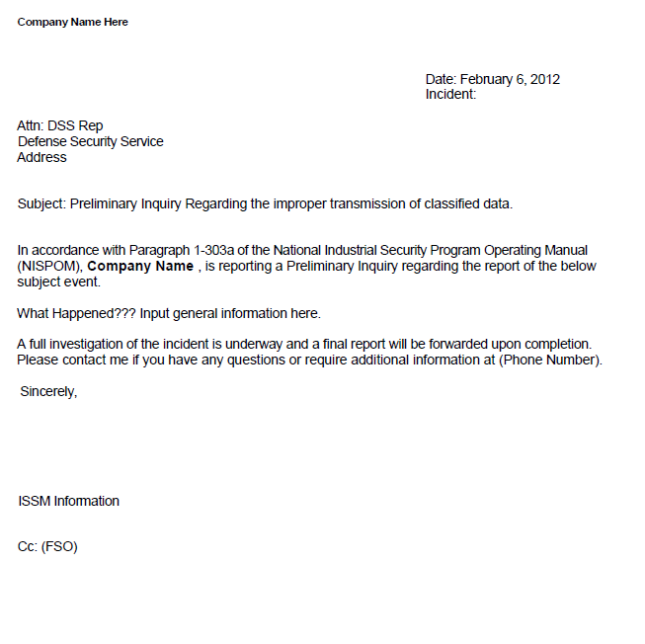
Initial Report
Timeline for Initial Report
Top Secret: 24 hours
Secret / Confidential: 72 hours
Use secure communication channel if available
Including details such as spill location and classification level will make the report classified “Confidential!”
11

Slide 12
Requirements
DoD 5220.22-M, NISPOM 1-303, Reports of Loss, Compromise, or Suspected Compromise
ISFO Process Manual Rev. 3.2 (p. 47)
Job Aid:
http://www.dss.mil/documents/cdse/ai-job-aid-for-industry.pdf
12

Slide 13
What to expect from DSS
Guidance (if needed) to prevent spread to other systems
Review of actions taken (or planned) to help ensure contaminated systems are properly cleaned
Questions to help guide the entire process to proper closure
Notes:
2

Slide 14
Incident Response Plans
Prepared in advance, before an incident
Provides a roadmap to follow when responding to incidents such as spills
Meets unique organizational requirements
Defines incidents, resources, and support
May be pre-approved by Data Owners, Customers, and/or DSS
Ref: ISFO Process Manual, Rev 3.2, (p. 44)
14

Slide 15
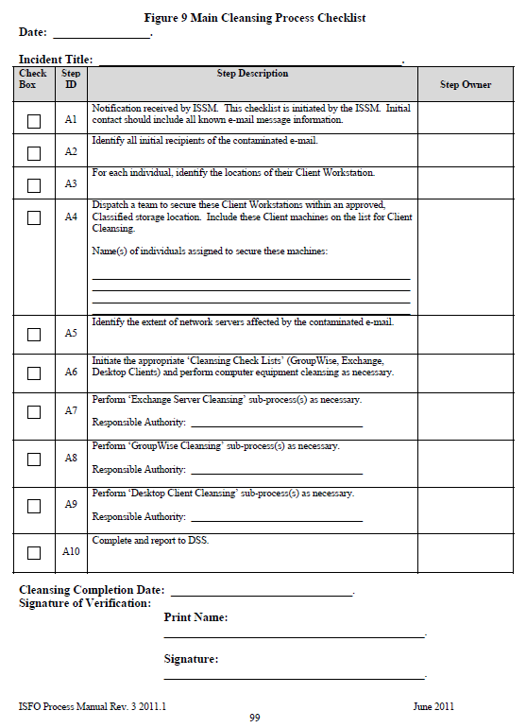
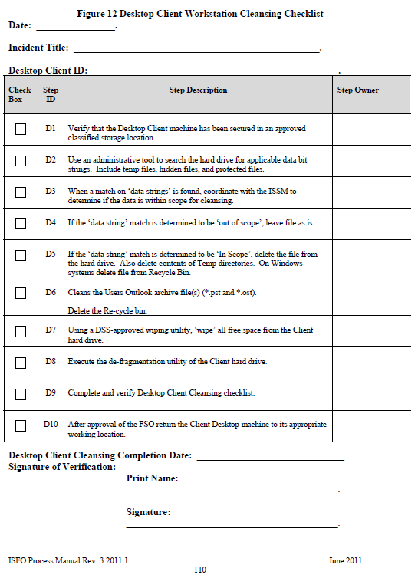
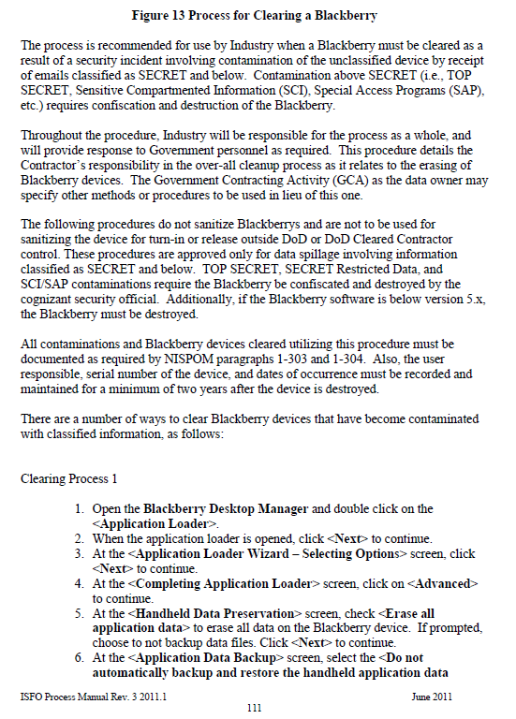
Utilize Available Checklists
Review information contained in the ISFO ODAA Process Manual…and be familiar with it!
Some Data Owners / customers may provide specific guidance / checklists to be used
Notes:
2

Slide 16
Many Spills Involve Email
What type of email system is involved?
Are the System Administrators cleared?
Where may backup copies of email be stored?
MS Exchange deleted item recovery
Offline storage and PSTs
Other examples?
Is my email system hosted internally, or by a third party outside of the company?
Internal systems are under complete control of facility
May not want to notify third-party companies of spills
16
Notes:
5

Slide 17
Other Information to Consider
What platforms and O/S’ are involved?
Are there any remote dial-ins/vpns?
Are there any other network connections?
How was the file or e-mail received and where was it placed or copied to?
Was the file or email deleted by the recipient?
Is RAID storage technology involved?
Identities of personnel involved and clearance levels of those individuals.
Was the information forwarded to others?
17
Notes:
5

Slide 18
Preparing to Clean Up the Spill
Overwrite utilities are typically used to “clean up” the spill on desktop and server magnetic media by overwriting the storage location
Not considered the same thing as sanitizing a classified hard drive (like we did in the “old days”)
May not be used some systems (i.e. email servers) that automatically reclaim/overwrite space after deletions
Identify/acquire approved media overwrite utilities to clean the suspect data from systems
Contact your DSS ISSP or the Gov’t Customer for assistance if needed
Notes:
Examples of Utilities
Unishred Pro 3.3.1 (EAL1)
BCWipe Total WipeOut
White Canyon Wipe Drive (EAL4)

Slide 19
Cleaning Up the Spill
Follow your incident response plan or other “pre-approved” procedure for spill cleanup
Utilize appropriate cleanup methods for the media involved in the incident
Approved overwrite utility based on media type
In some cases, destruction may be necessary
Third-party service providers may complicate matters
Should external providers be contacted?
Will the provider allow cleared employees access to clean up the spill?
Can the spill be eradicated from a “cloud” environment?

Slide 20
Prepare the Final Report
After spill clean up actions are completed.
Assist with information needed for damage assessment if requested
Details of what, who when, why, how, etc
Culpability determination and other adverse history for personnel
Were the responsible individuals disciplined or retrained?
Due within 15 days of initial notification
Don’t forget to include a mention of GCA or Data Owner notification and response received

Slide 21
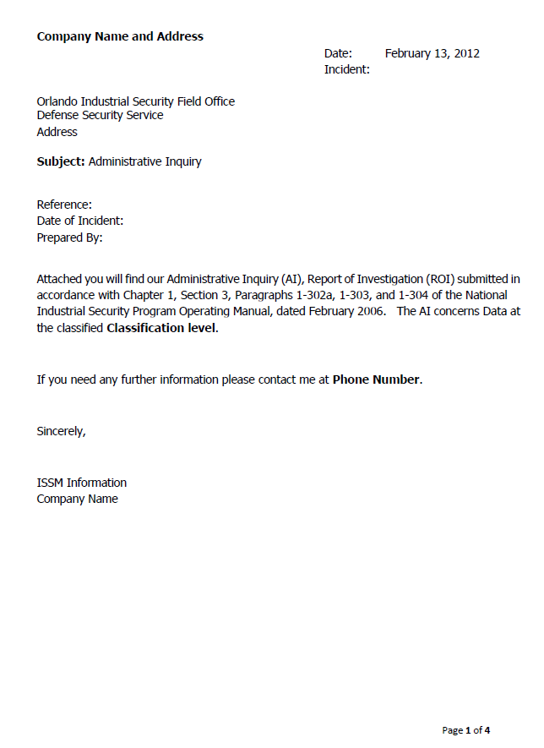
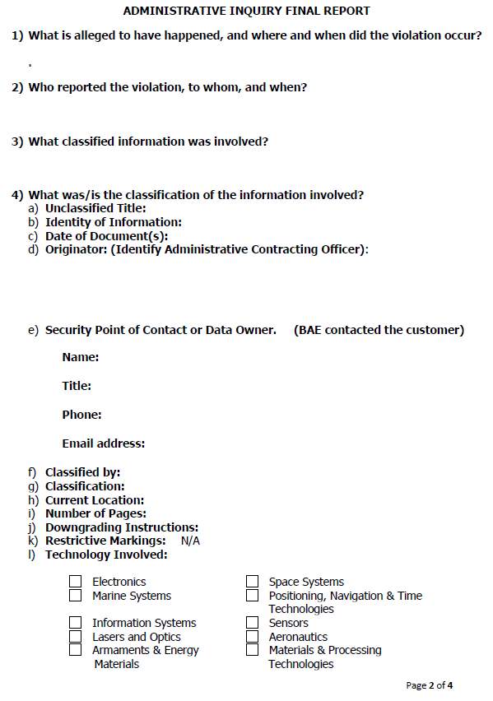
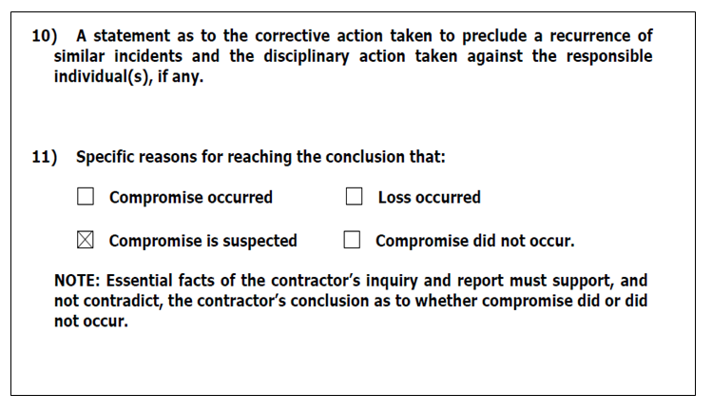
Sample Administrative Inquiry
NISPOM Para 8-103b,c
21

Slide 22
Summary
We Reviewed and Discussed
The description or definition of a classified data spill
Some common causes of data spills
Personnel responsibilities during a spill
Facility reporting requirements for spills
Incident response plans
Additional spill cleanup considerations
The “Final Report,” or administrative inquiry

